Slide 1
User Interface Design
Instructor: Dang Tu Linh

Slide 2
Course Objective
To understand the need of UI Design.
To appreciate the considerations behind good UI design.
To be aware of general UI design principles.
Notes:
Course Objective
In order to understand the issues surrounding user interfaces, it helps to understand what, exactly, a user interface is, and how they've evolved to the point they're at today.

Slide 3
Session Plan
What is a User Interface?
History of the evolution of user Interface
Process of UI design
Elements of GUI
Good and bad UI’s
UI Design - Principles and guidelines
Web UI Design Issues
Notes:
1 day course

Slide 4
What is a User Interface
UI is the part of a computer and its software that people can see, hear, touch, talk to, or otherwise understand or direct.
Two components: input and output.
Users interact with the computers with the help of
  video screens
  keyboards
  pointing devices
Notes:
Any machine that requires interaction with human beings will have some sort of user interface.
Traditional computers communicated to the users with the help of punch cards . Modern computers interact with users with the help of video screens and typewriter-style keyboards and pointing devices.
The user interface should represent the capabilities of the entire system. The more complex the system, the more important the user interface. The user interface should help the user build an intuitive sense ,of how the system works. When a system feels natural to use, the user interface is doing a good job. A good user interface helps tailor the system to the user.

Slide 5
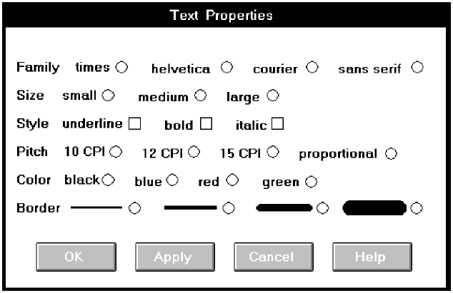
Importance of Quality User Interfaces
User Interface is also called as the front end of the system
Bad UI design make not-good first impression about the system.
Notes:
Quality User Interface
UI Design isn't just arranging stuff on a page or in a dialog box It may seem a simple and side aspect of the whole application; in fact it is, perhaps, the
most important part of the whole system. User Interface is also called as the front end of the system And front end always the first impression about the system. Remember you do not have another chance to make the first impression.
Looking an example, It looks bad but you do not realize how really horrible it is until you look at Figure in next slide, a redesigned version.

Slide 6
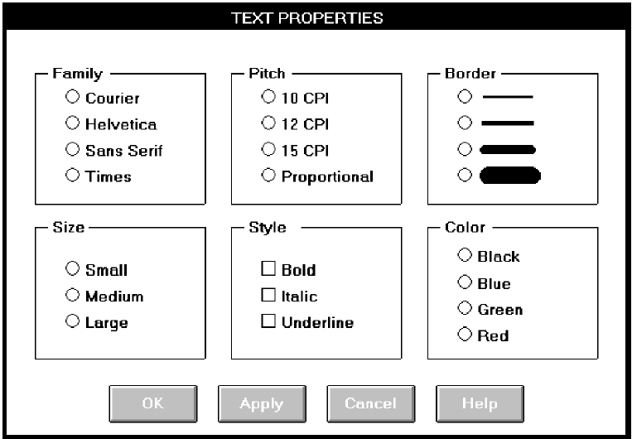
Importance of Quality User Interfaces
Good screen design requires an understanding of many things.
Notes:
A redesigned screen.
Good screen design requires an understanding of many things. Included are the characteristics of people: how we see, understand, and think. It also includes how information must be visually presented to enhance human acceptance and comprehension, and how eye and hand movements must flow to minimize the potential for fatigue and injury. Good design must also consider he capabilities and limitations of the hardware and software of the human-computer interface.
Important human issues that should consider:
People have a limited short-term memory. If you present users with too much information at the same time, they may not be able to take it all in.
We all make mistakes, especially when we have to handle too much information or are under stress. When systems go wrong and issue warning messages and alarms, this often puts more stress on users, thus increasing the chances that they will make operational errors.
We have a diverse range of physical capabilities. Some people see and hear better than others, some people are color-blind, and some are better than others at physical manipulation.
We have different interaction preferences. Some people like to work with pictures, others with text.

Slide 7
The process of User Interface Design
Phases (life cycle) of UI Design
1. Discovery
2. Design
3. Delivery
Notes:
To achieve Quality User Interface, All phases of the UI design need to be strictly followed

Slide 8
1. Discovery
Read the documents
– Marketing Requirements
– Functional Specification
Interviews
– Interview different users of the system
– Understand the differences among the requirement of different users of the UI
Brainstorming
– Brainstorm among the team members
Notes:
Discovery stage of UI design corresponds to requirement analysis phase of SDLC (Software Development Life Cycle) In this step, the research needs to be carries out regarding the various users of the system & business requirements analysis related to UI. In this step, we also need to figure out who the users are, the expertise level & the language of the users We also need to find out what is their objective being using this UI.

Slide 9
1. Discovery
Visual design
– Design sample screens
Verify Design directions
– Test the sample screens

Slide 10
2. Design
Concept development
– Develop according to the idea which is best amongst the output of the last phase
Create a site map
– Create the outline by taking help of Flow diagrams
Prototyping
– Create interactive working prototype
Notes:
Concept development
In Concept development we choose one amongst the various discussed ways of design. Then we develop some initial ideas and select the best features from each one.
Various tools are available for visual design
E.g. Composer
Frontpage
PACBASE etc

Slide 11
2. Design
Visual design
– Develop complete design model using the selected tool for design
Usability testing
– Test the Visual Design

Slide 12
3. Delivery
Create Screen Design specification
– In this stage we create the document containing the specification of the design which comes out as an output of the previous stages
– Help the programmers to understand and develop the code according to the specification
Notes:
This stage corresponds to the release stage of the software life cycle.
In short, in this phase we are delivering the Design which is the output of the last phase.

Slide 13
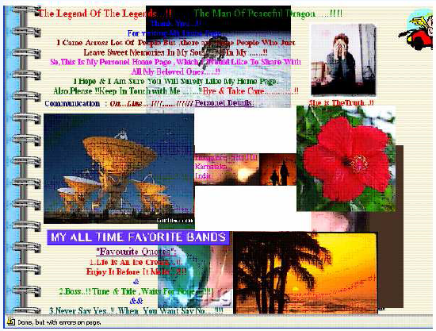
Elements of User Interface Design
Example of the worst UI Design
Notes:
The home page of a personal web site is shown in the slide
The interface consists of
a) scattered text
b) series of pictures pasted above the text in the illogical order.
c) random animation given to these pictures
The animation makes it impossible for a reader to read anything on the screen for more than few seconds.
The data to be shown on the screen was fairly simple and consistent, but the design of the interface was very poorly done.
The jazzy effects used in incorrect manner have spoiled the design of the web page.

Slide 14
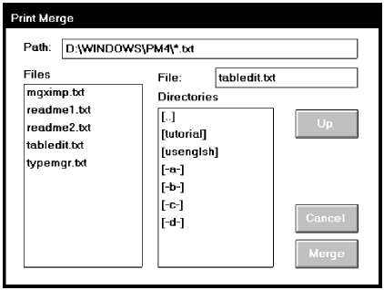
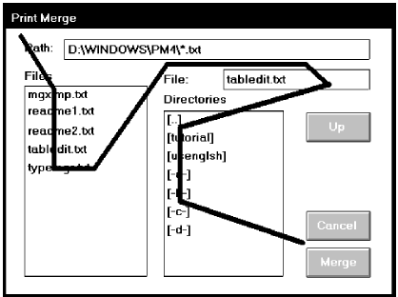
Example 1
Notes:
What follows are examples of poor and proper design.
Analyze them for problems, including inconsistencies between them.

Slide 15
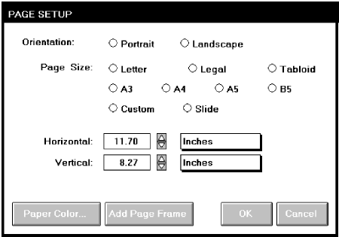
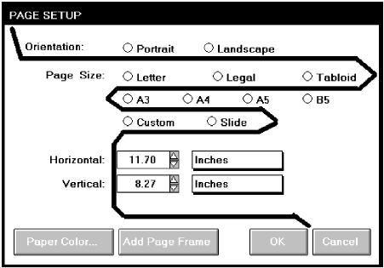
Example 2

Slide 16
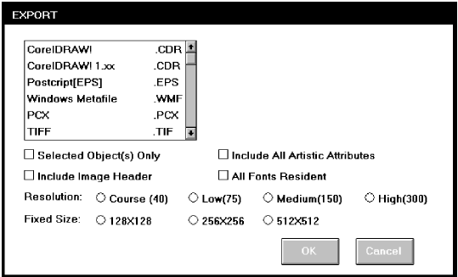
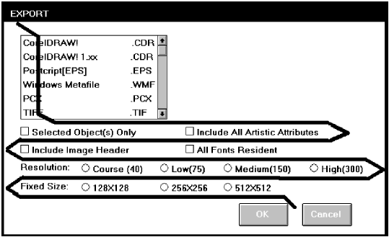
Example 3

Slide 17
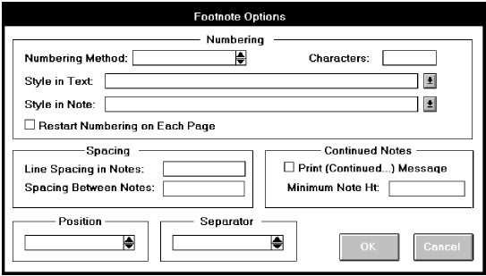
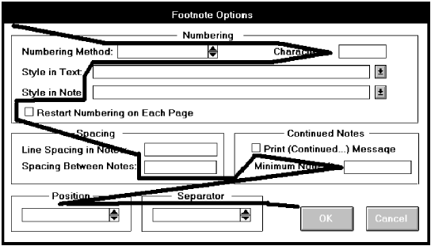
Example 4

Slide 18
Assignment
Re-design screens of examples in previous slides.
Notes:
Divide class into 4 teams and assign each examples for each team.
Approx time: 20 min.

Slide 19
Good vs Bad UI Design
Which UI can be called as bad UI?
– Does not meet the expectations of the target user
– Does not Serve the purpose for which it was made
Which UI can be called as good UI?
– Meets the expectation of technically skilled as well as unskilled users expectations
– Serves the purpose for which it was made
Notes:
How to create good interfaces?
Collect specific details such as:
What are the user's goals?
What are the user's skills and experience?
What are the user's needs?
Follow the guidelines of UI design after collecting this information.

Slide 20
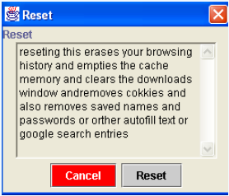
Example of Bad UI Design
Notes:
Here are some reasons that make it bad:
The text displayed on dialog box is not user friendly.
There are spell mistakes in the text.
The Multi-line Textbox is not the accurate component to be used for this message.
The cancel button made red and shifted to the left
Neither button is made the default button
Etc.

Slide 21
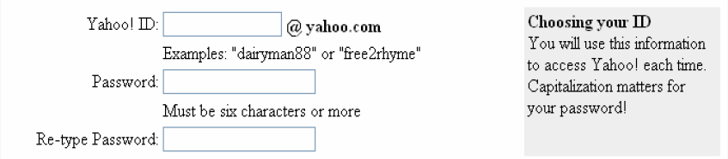
Example of Simple, Good UI Design
Notes:
This is example of good design because
a) Sample of the data to be entered is shown
b) The validation rules are put up upfront
c) A caution note is given in a separate box
UI should be designed like designing a building. Each element should be kept at proper place. Required functionality should be achieved.

Slide 22
Q & A

